Slide 1

CMPUT 328
Getting Started with Colab, Numpy and PyTorch

Slide 2
Contents
Google Colab
Numpy
Image Operations
Pytorch

Slide 3
Google Colab

Slide 4
Google Colab
Cloud based runtime environment for executing Python code
Supports GPU, TPU and CPU acceleration
VM like environment - allows installing python (pip) and non-python (apt) packages
Jupyter Notebooks
Interactive python wrapper
Cells – code and markdown text
Real time collaboration just like Google Docs
Overview

Slide 5
Google Colab - Overview

Slide 6
Google Colab – Data Handling

Slide 7
Python Basics

Slide 8
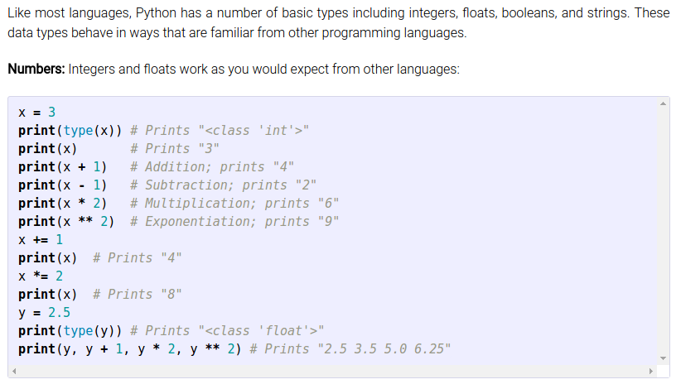
Basic data types

Slide 9
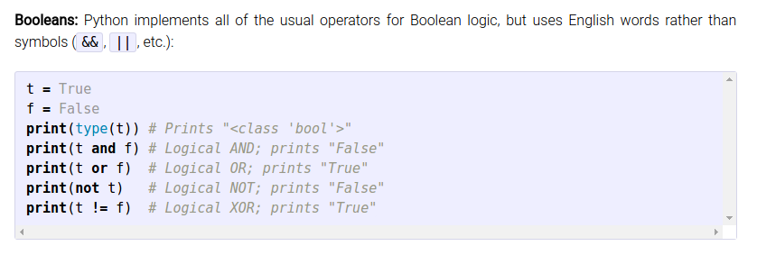
Basic data types

Slide 10
Basic data types

Slide 11
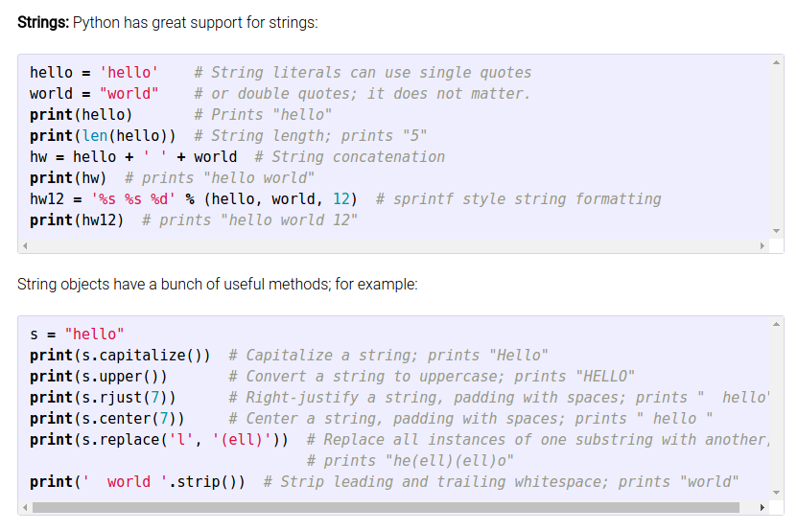
Basic data types

Slide 12
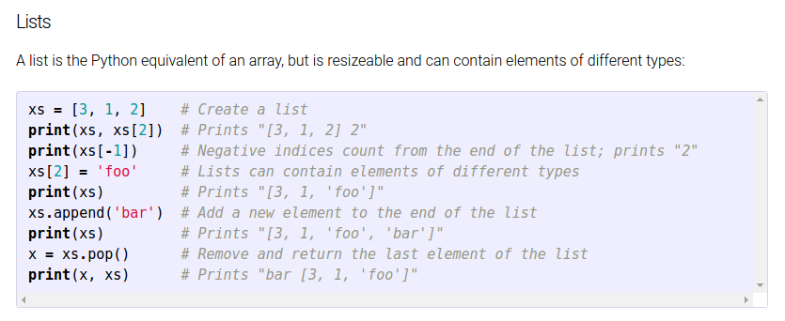
Containers - List

Slide 13
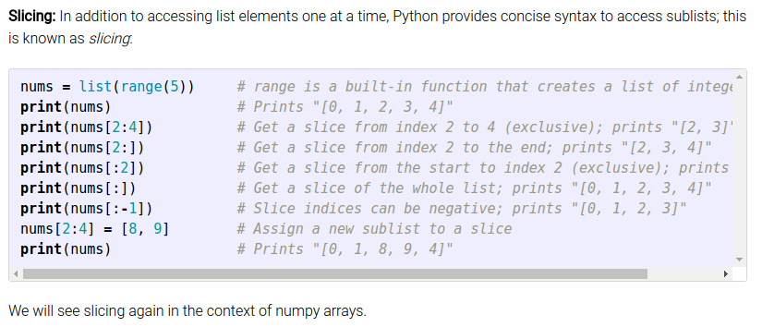
Containers – List Slicing
Num skip between elements
Syntax:
a[start:end:step]
Negative start, end: returns the nth element from the right-hand side of the list
Omitted: start = 0, end = len(a), step=1
Inclusive
Start from 0
exclusive
Can be negative or omitted

Slide 14
Containers – List Slicing
Syntax:
a[start:end:step]
Other examples:
Even index elements: a[::2]
Special case - reverse list: a[::-1]
Inclusive
Start from 0
exclusive
Can be negative or omitted

Slide 15
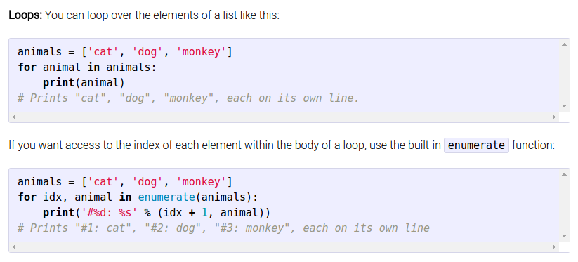
Containers – List Looping

Slide 16
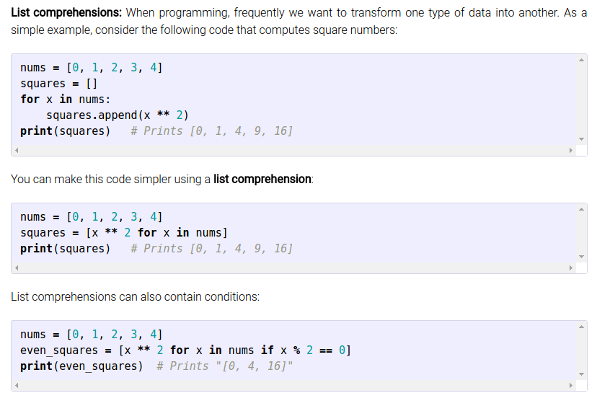
Containers – List Comprehension

Slide 17
Container - Others
Dictionary: Stores (key, value) pairs. A map from keys to values
Set: unordered collection of distinct elements
Tuple: immutable ordered list of values

Slide 18
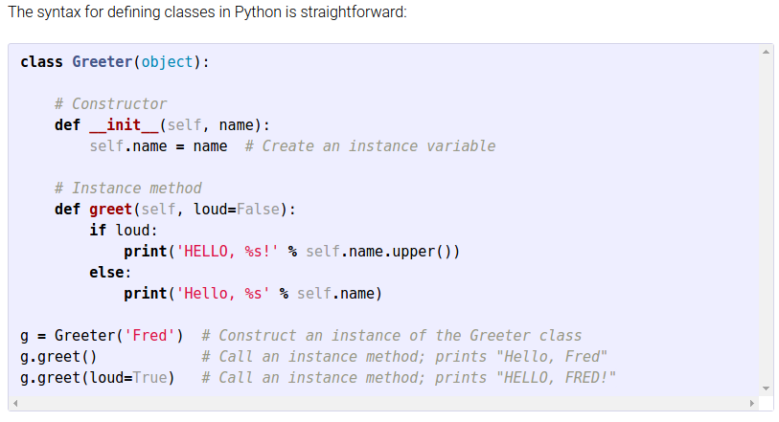
Functions and Classes

Slide 19
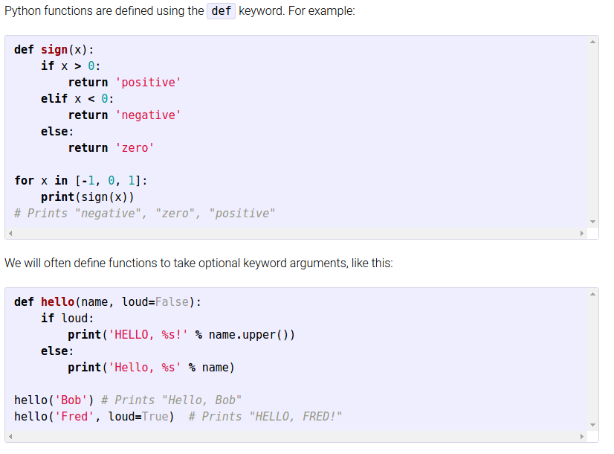
Functions and Classes

Slide 20
Numpy

Slide 21
Array
Grid of values, all of the same type
The number of dimensions is the rank of the array
The shape of an array is a tuple of integers giving the size of the array along each dimension.

Slide 22
Array – Array Creation
Initialize numpy array from list
a = np.array([1, 2, 3], dtype=np.float32)
2D, 3D,... array from nested list:
b = np.array([[1, 2, 3],
[4, 5, 6],
[7, 8, 9]])
import numpy as np

Slide 23
Array – Array Creation
Other:
np.zeros((4, 4), dtype=np.uint8)
np.ones
np.full
np.eye
np.random.random
np.ones_like
np.zeros_like
np.full_like

Slide 24
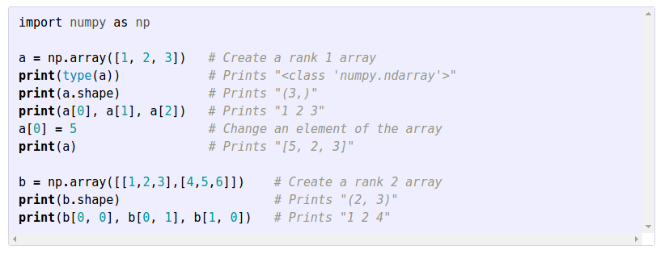
Array Indexing – Integer Indexing
Access elements using square bracket:

Slide 25
Array Indexing - Integer indexing
You can specify which element of array A to access using 2, 3, 4 one dimensional arrays depending whether A is 2D, 3D, 4D... array
Example:
a = np.array([[1,2], [3, 4], [5, 6]])
print(a[[0, 1, 2], [0, 1, 0]])
print(np.array([a[0, 0], a[1, 1], a[2, 0]]))

Slide 26
Array Indexing– Boolean Indexing
Use a boolean array B that has the same shape as array A to index array A.
A[B] → elements in A where the same location in B equal True will be indexed
Example: Find all element in array A that is greater than 2 and assign them to -1:
A[A > 2] = -1

Slide 27
Array Indexing – Slicing
Similar to python list
For multidimensional array:
Specify a slice for each dimension
If a dimension is omitted, it gets all elements of that dimension
Rank of output array is the same as input array

Slide 28
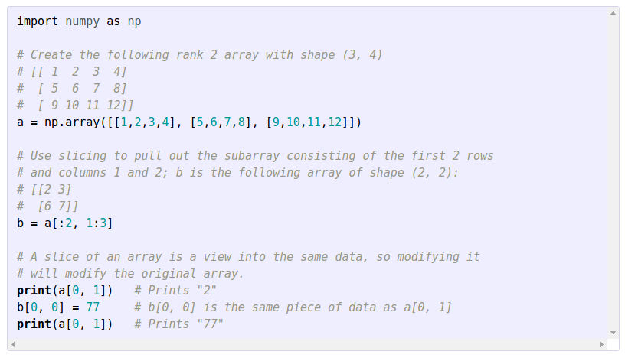
Array Indexing – Slicing

Slide 29
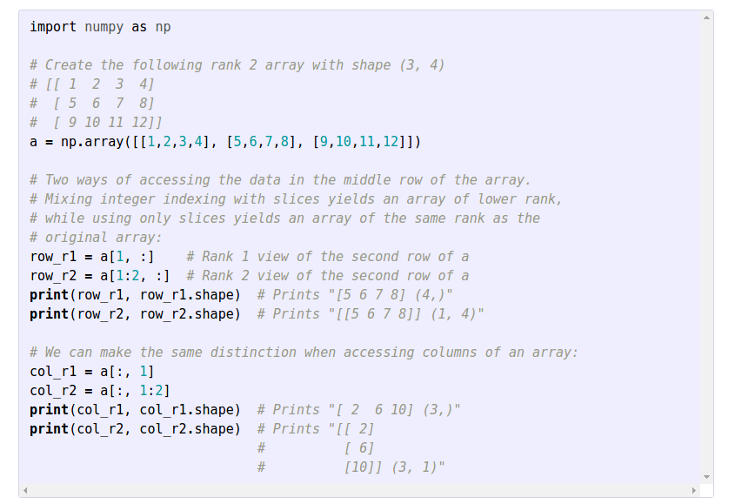
Array Indexing – Slicing
Mixing integer indexing and slice indexing: For each integer indexing, rank of output matrix will be decreased by 1.
Mixed indexing. Output
will have shape (4)
Slice indexing. Output
will have shape (1, 4)

Slide 30
Array Indexing – Ellipsis (…)
Indexing with unknown number of dimensions
Ellipsis indicates a placeholder for the rest of the array dimensions not specified
Think of it as indicating the full slice [:] for all the dimensions in the gap it is placed
a[..., 0] : 3D → a[:, :, 0], 4D →a[:, :, :, 0]
a[0, ...] : 3D → a[0, :, :], 4D →a[0, : , :, :]
a[0,...,0] : 3D → a[0, :, 0], 4D →a[0, :, :, 0]
a[0,1,...,0] : 4D →a[0, 1, :, 2], 5D →a[0, 1, :, :, 2]
nD → However many colons in the middle make up the full number of dimensions

Slide 31
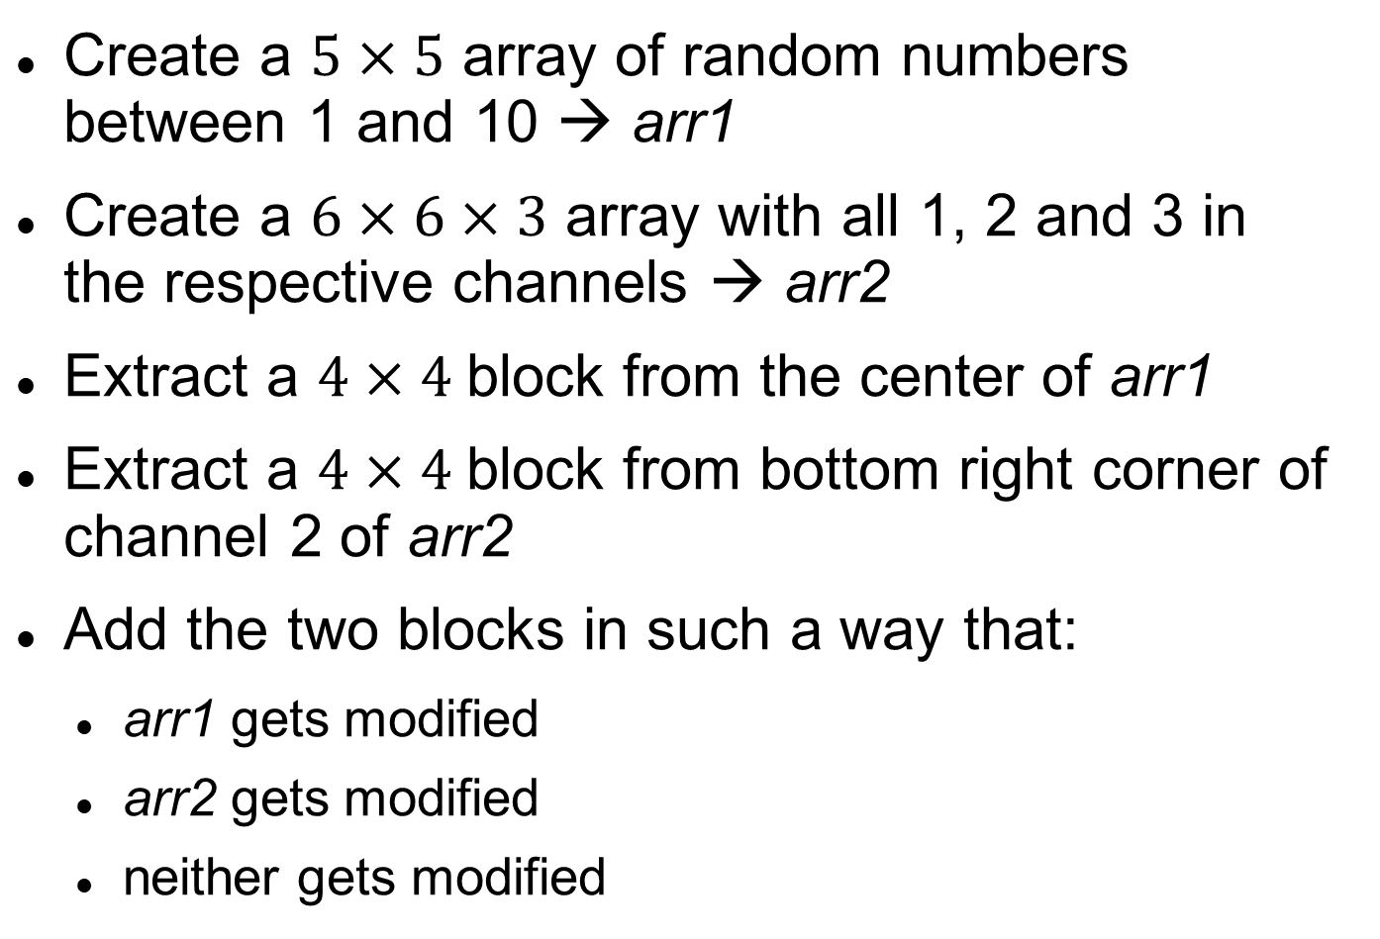
Array Indexing – Exercise
Create a $5×5$ array of random numbers between 1 and 10 → arr1
Create a $6×6×3$ array with all 1, 2 and 3 in the respective channels → arr2
Extract a $4×4$block from the center of arr1
Extract a $4×4$block from bottom right corner of channel 2 of arr2
Add the two blocks in such a way that:
arr1 gets modified
arr2 gets modified
neither gets modified

Slide 32
Numpy data types
np.uint8
np.int32
np.int64
np.float16
np.float32
np.float64
...

Slide 33
Array Math
+, -, *, /
A + B, A – B, A * B, A / B
np.add, np.subtract, np.multiply, np.divide
All are element-wise operations
For matrix multiplication, use np.dot or np.matmul:
A.dot(B)
np.dot(A, B)
np.matmul(A, B)

Slide 34
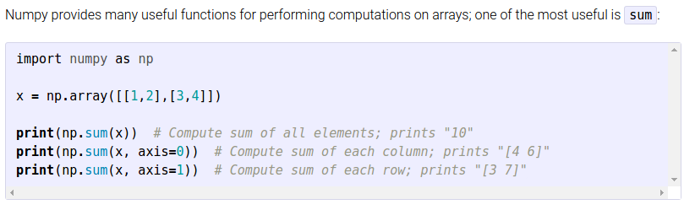
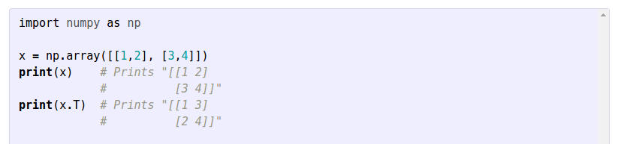
Array Math
Other unary operations: sum, max, min, transpose...
Can specify axis for some operations

Slide 35
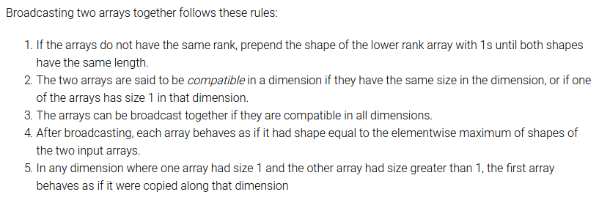
Array Broadcasting
Powerful mechanism that allows numpy to work with arrays of different shapes when performing arithmetic operations

Slide 36
Array Broadcasting
Example 1:
image = np.random.random((400, 400, 3))
means = np.asarray([0.1, 0.2, 0.3])
print(image - means)
Shape of image: (400, 400, 3)
Shape of means: ( 1, 1, 3) ← (3)
Broadcasted means: (400, 400, 3)
Broadcasted means will have
[:, :, 0] = 0.1
[:, :, 1] = 0.2
[:, :, 3] = 0.3

Slide 37
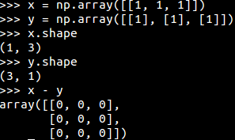
Array Broadcasting
Example 2:
Be careful! This can cause unnoticeable bugs in your code

Slide 38
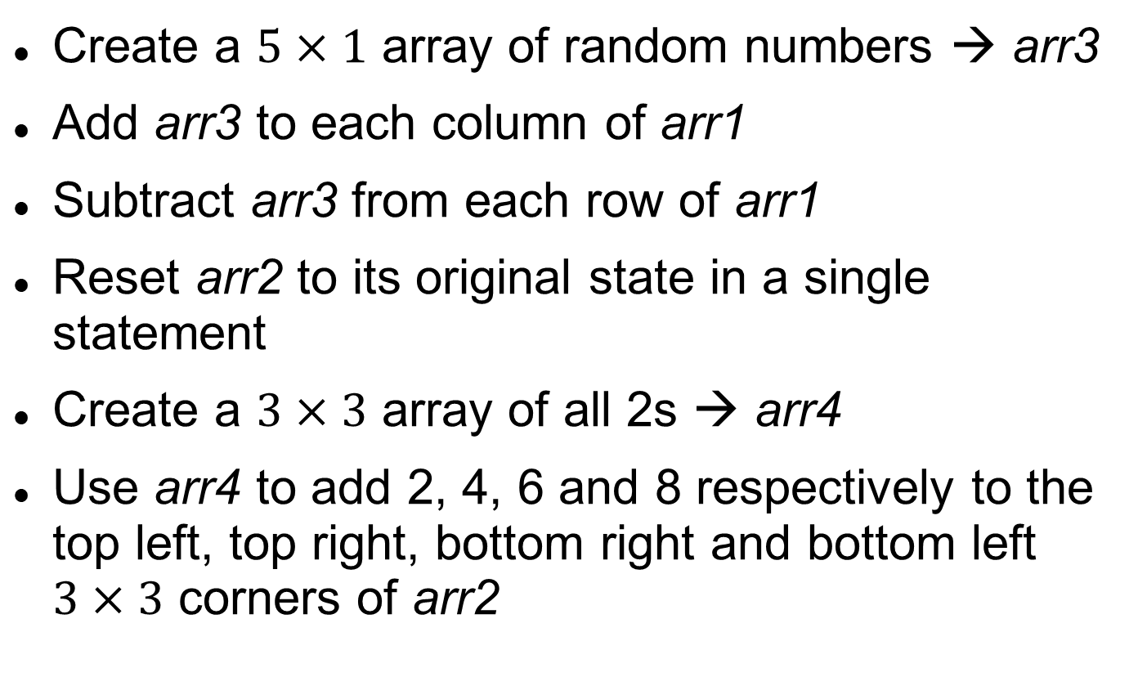
Array Broadcasting – Exercise
Create a $5×1$ array of random numbers → arr3
Add arr3 to each column of arr1
Subtract arr3 from each row of arr1
Reset arr2 to its original state in a single statement
Create a $3×3$ array of all 2s → arr4
Use arr4 to add 2, 4, 6 and 8 respectively to the top left, top right, bottom right and bottom left $3×3$ corners of arr2

Slide 39
Image operations

Slide 40
Image operations - Libraries
OpenCV
Implemented in C++
Faster, more powerful and better documented
Slightly more buggy / less supported
Stores images as BGR
scikit-image
Implemented in Python and Cython
Easier to use

Slide 41
Image operations - Read, Write, Resize
OpenCV
import cv2
im = cv2.imread('image.jpg')
im_resized = cv2.resize(im, dsize=(0,0), fx=4, fy=4)
cv2.imwrite(“im_resized.jpg”, im_resized)
skimage
from skimage.io import imread, imsave
from skimage.transform import resize
im = imread('image.jpg')
im_resized = resize(im, output_shape=(500, 500))
imsave(“im_resized.jpg”, im_resized)

Slide 42
Image operations - Show
OpenCV
# import cv2
# cv2.imshow(“image”, im) → causes Jupyter to crash
from google.colab.patches import cv2_imshow
cv2_imshow(im)
skimage / matplotlib
import matplotlib.pyplot as plt
from skimage.io import imshow
plt.imshow(im)
imshow(im)

Slide 43
Image operations - Filter
OpenCV
import cv2
im_sobel = cv2.Sobel(im)
im_median = cv2.GaussianBlur(im)
im_median = cv2.medianBlur(im)
skimage
from skimage.filters import sobel, gaussian, median
im_sobel = sobel(im)
im_gauss = gaussian(im, sigma=3)
im_median = median(im)

Slide 44
Image operations - Exercise
Download an image from internet or use an existing image
Upload it to Google Drive
Mount your Google Drive and authorize
List the contents of your Google Drive to figure out the path to that image
Read that image and show it
Resize it to double its original size
Apply Sobel filtering to the resized image
Show the resized and filtered images
Save the resized and filtered images to Google Drive
Download the image and open it locally

Slide 45
PyTorch
Overview

Slide 46
Numpy Interoperability
Pytorch arrays → tensors
From Numpy:
import torch
tensor = torch.from_numpy(np_arr)
tensor = torch.tensor(np_arr)
To numpy:
np_arr = cpu_tensor.numpy()
np_arr = gpu_tensor.cpu().numpy()
np_arr = tensor_with_grad.detach().cpu().numpy()

Slide 47
Running on Different Devices
GPU:
device = torch.device("cuda“)
gpu_tensor = torch.tensor(np_arr, dtype=torch.float, device=device)
gpu_tensor = tensor.to(device)
Second GPU:
device = torch.device("cuda:1“)
CPU:
device = torch.device(“cpu“)
TPUs currently not supported

Slide 48
Basic operations
Close parallel with numpy functions
np.zeros → torch.zeros
np.ones → torch.ones
np.add → torch.add
np.matmul → torch.matmul
np.random.rand → torch.rand

Slide 49
Broadcasting
Many operations support Numpy rules
Two tensors are broadcastable if following rules hold:
Each tensor has at least one dimension.
When iterating over the dimension sizes, starting at the trailing dimension, the dimension sizes must either be equal, one of them is 1, or one of them does not exist.

Slide 50
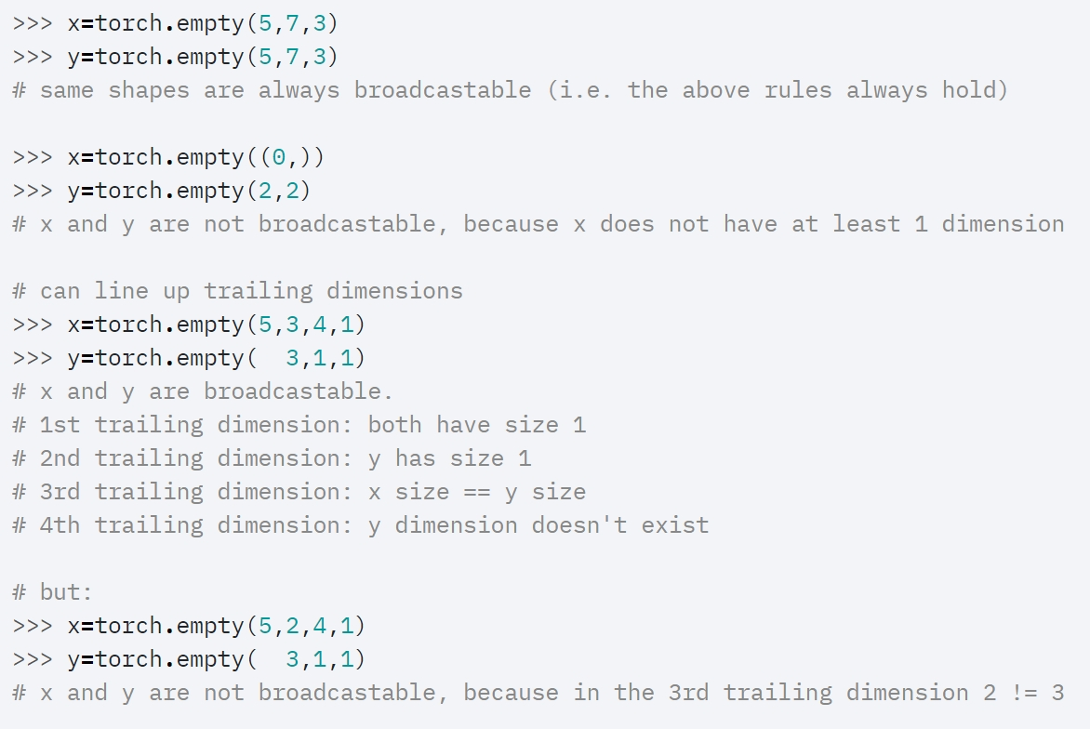
Broadcasting - Examples

Slide 51
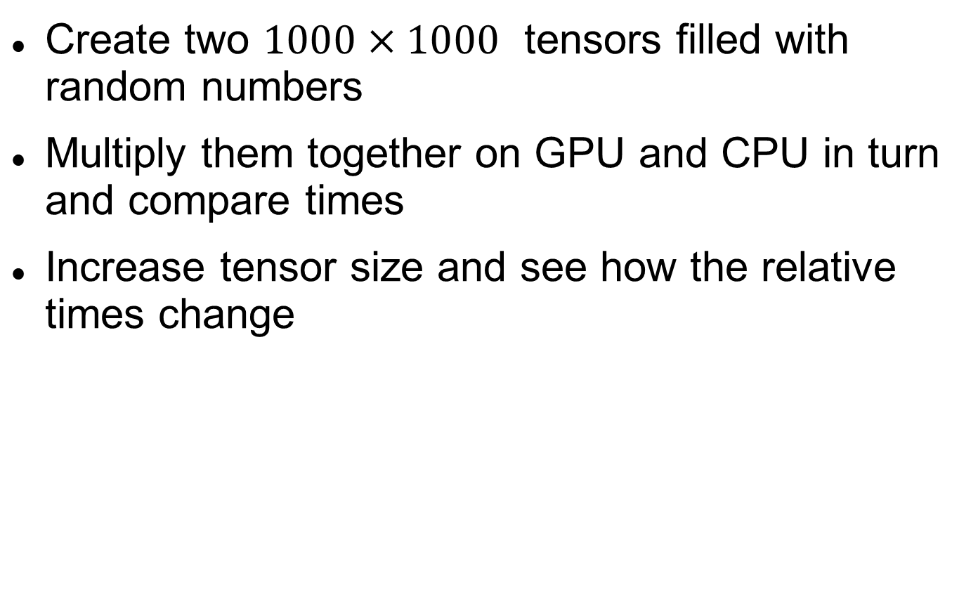
PyTorch– Exercise
Create two $1000×1000$ tensors filled with random numbers
Multiply them together on GPU and CPU in turn and compare times
Increase tensor size and see how the relative times change

Slide 52
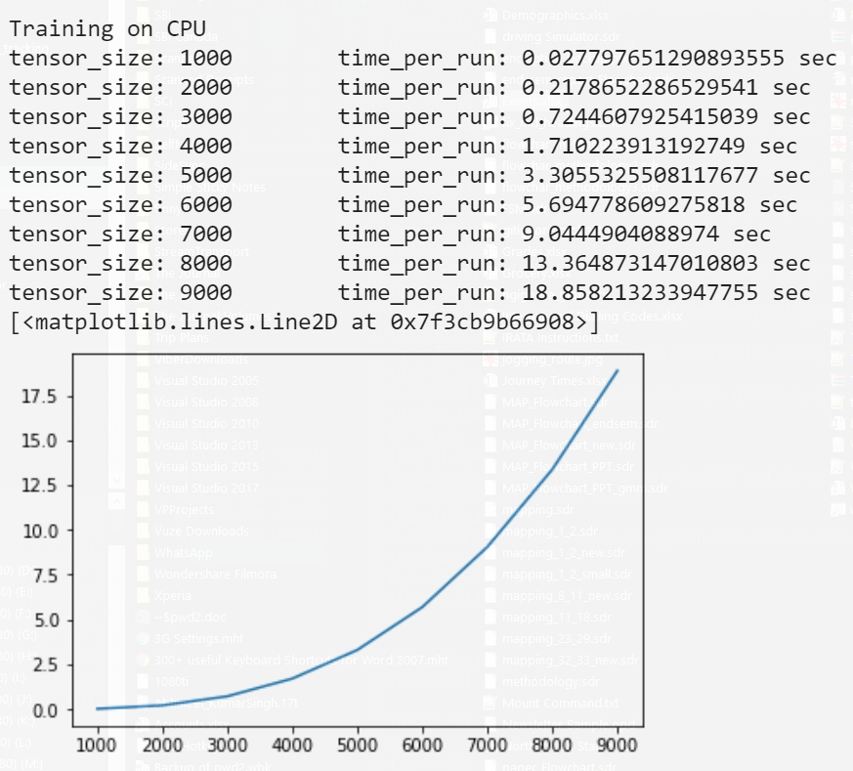
PyTorch – Training on CPU

Slide 53
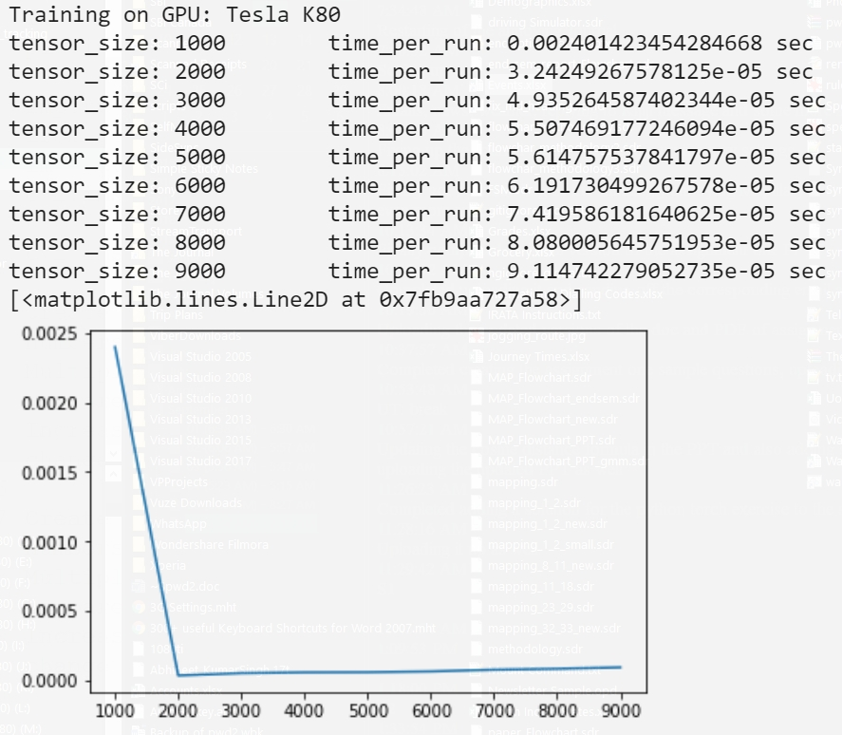
PyTorch – Training on GPU

Slide 54
Torchvision
“popular datasets, model architectures, and common image transformations for computer vision”
torchvision.transforms, torchvision.transforms.functional
Combine transforms: Compose
Cropping: CenterCrop,
Conversion: Grayscale
Size change: Pad, Resize
Augmentation: RandomCrop, RandomAffine, RandomHorizontalFlip, RandomRotation

Slide 55
TensorBoardX
Installation
!pip install tensorboardX
Basic use
from tensorboardX import SummaryWriter
writer = SummaryWriter(logdir=dir_path)
writer.add_scalar('train/total_loss', loss, iteration)
Advanced use
writer.add_scalars, writer.add_image, writer.add_text, writer.add_histogram, writer.add_pr_curve, writer.add_audio

Slide 56
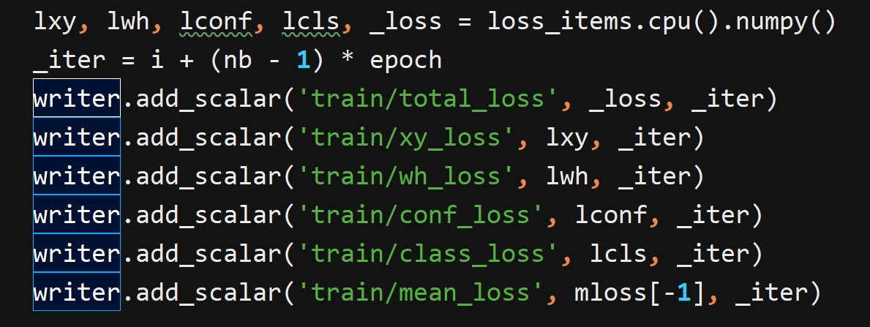
TensorBoardX – YOLO Example

Slide 57
Thanks !

